Slide 1

Week 31/03/2023

Slide 2
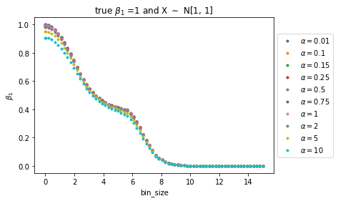
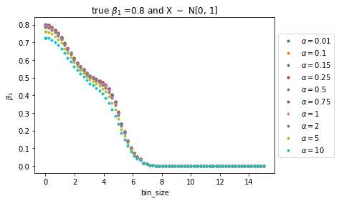
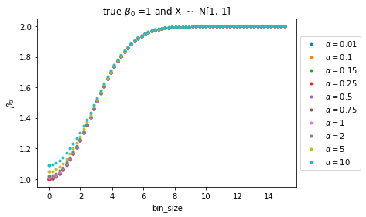
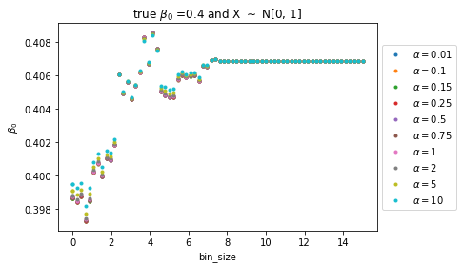
LINear regression
PLAYING WITH RIDGE

Slide 3
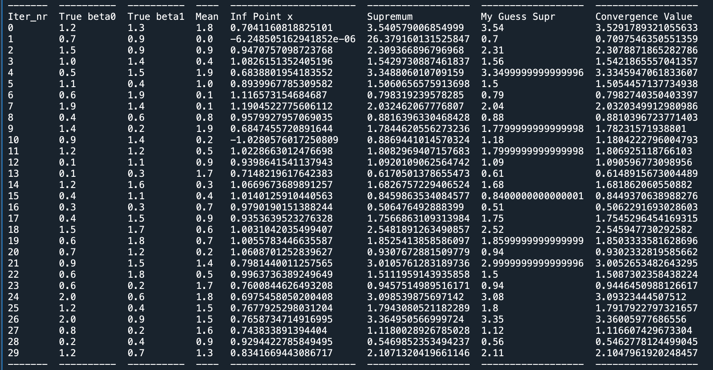
Linear regression – logistic shape of curve bin_size against estimatded beta_0
Convergence value can be approximated by true beta 0 + true beta 1 * sample mean X
The plot is not monotonic (not logistic) when betas are really small?

Slide 4
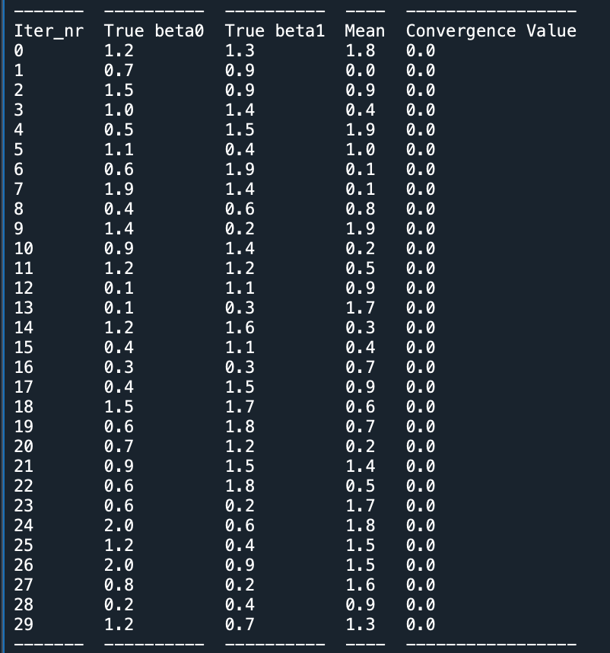
Linear regression – logistic shape of curve bin_size against estimatded beta_1
They are all monotonic, going towards 0

Slide 5
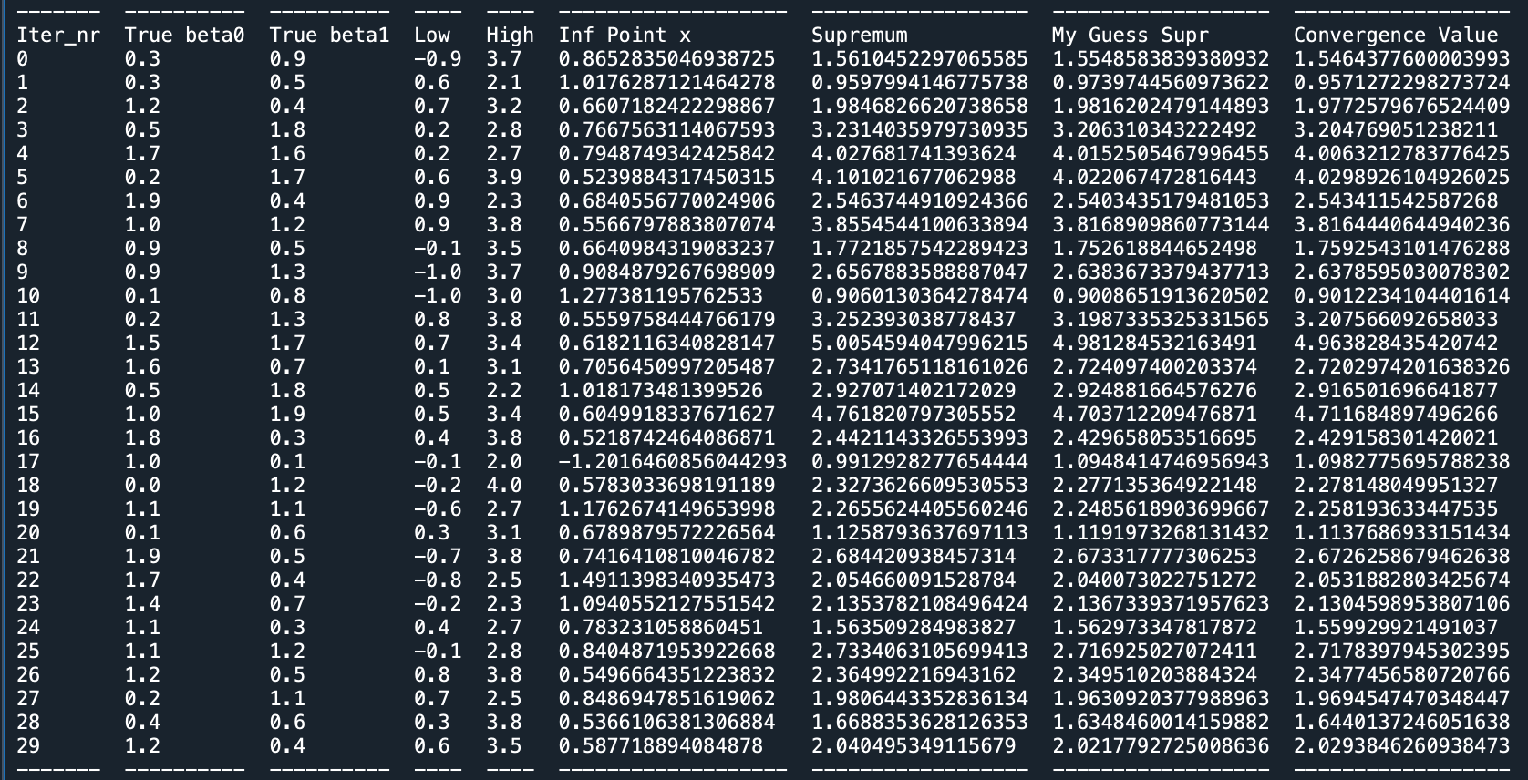
X uniformly distriubuted

Slide 6
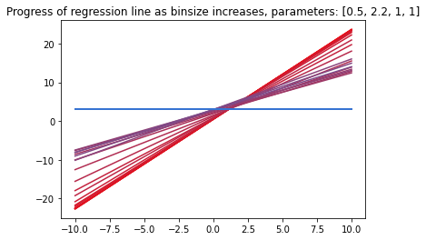
From red to blue the binsizes increase

Slide 7
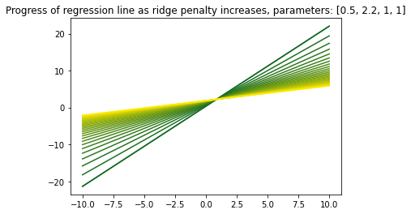
From green to yellow the ridge penalty increase

